Slide 1

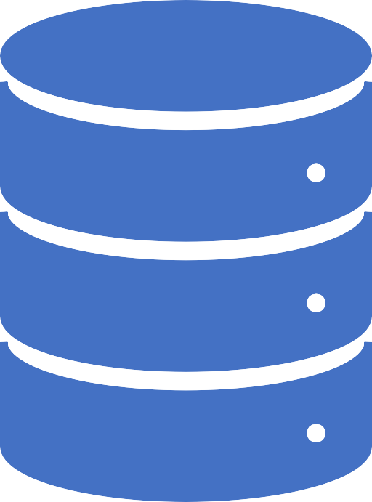
Database System [Generalization, Specialization and Aggregation]

Slide 2
Generalization is like a bottom-up approach in which two or more entities of lower level combine to form a higher level entity if they have some attributes in common.
In generalization, an entity of a higher level can also combine with the entities of the lower level to form a further higher level entity.
Generalization

Slide 3
Generalization is more like subclass and superclass system, but the only difference is the approach. Generalization uses the bottom-up approach.
In generalization, entities are combined to form a more generalized entity, i.e., subclasses are combined to make a superclass.
Generalization

Slide 4
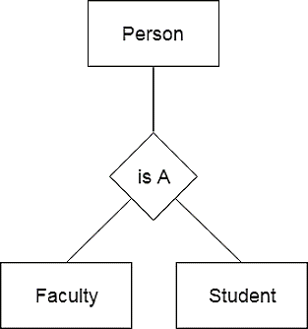
Faculty and Student entities can be generalized and create a higher level entity Person.
Generalization Example

Slide 5
Specialization is a top-down approach, and it is opposite to Generalization. In specialization, one higher level entity can be broken down into two lower level entities.
Specialization is used to identify the subset of an entity set that shares some distinguishing characteristics.
Normally, the superclass is defined first, the subclass and its related attributes are defined next, and relationship set are then added.
Specialization

Slide 6
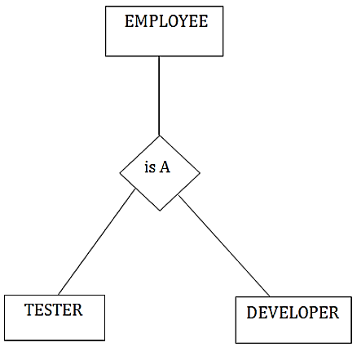
In an Employee management system, EMPLOYEE entity can be specialized as TESTER or DEVELOPER based on what role they play in the company.
Specialization Example

Slide 7
Aggregation
In aggregation, the relation between two entities is treated as a single entity.
In aggregation, relationship with its corresponding entities is aggregated into a higher level entity.

Slide 8
Center entity offers the Course entity act as a single entity in the relationship which is in a relationship with another entity Visitor.
In the real world, if a Visitor visits a coaching center then he will never enquiry about the Course only or just about the Center instead he will ask the enquiry about both.
Aggregation Example

Slide 9
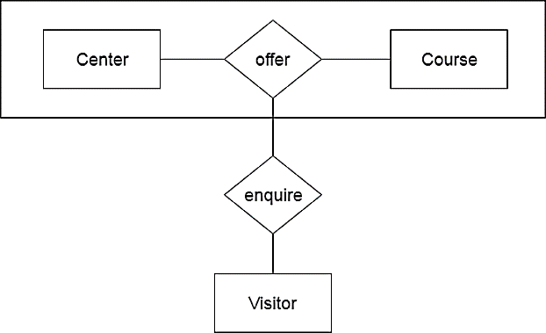
Aggregation Example

